Slide 1
Team Based Care and Huddle Training
Prepared for Care Team Members at Federally Qualified Health Center as an example

Slide 2
Learning Objectives
Understand the importance of Team Based Care
Know how Huddles facilitate and improve Team Based Care
Recognize the characteristics of an effective Huddle
Be familiar with the Huddle Checklist and workflow at your health center

Slide 3
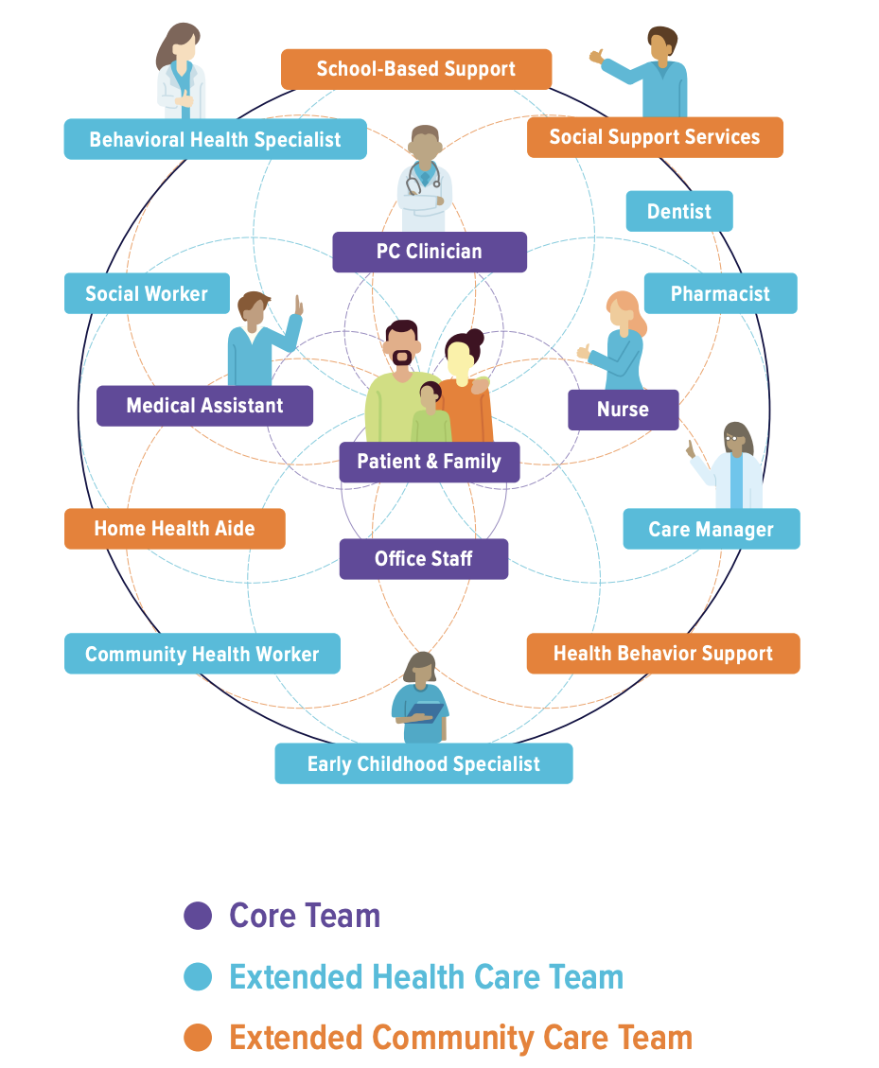
What is a Care Team?
Ideal State:
A clinical care team consists of the health professionals—physicians, registered nurses, clinical pharmacists, and other healthcare professionals—with the training and skills needed to provide high-quality, coordinated care specific to the patient’s clinical needs and circumstances.
Patient is the center – the goal is for everyone to collaborate with each other.
Notes:
Aligns with PCMH – the patient is at the center
https://nap.nationalacademies.org/read/25983/chapter/9
https://www.elationhealth.com/resources/blogs/what-is-a-clinical-care-team

Slide 4

What is a Huddle?
A brief in person meeting of the patient care team to increase efficiency and access in the office setting
Huddles provide an opportunity to anticipate patient needs and prepare for changes in staffing and logistics so the day runs more smoothly
Typical length of huddles: 5-10 minutes
Takes place daily at a regularly scheduled time, usually before the first patient of the day
  They can take place twice a day, if needed. One in the morning and one in the afternoon

Slide 5
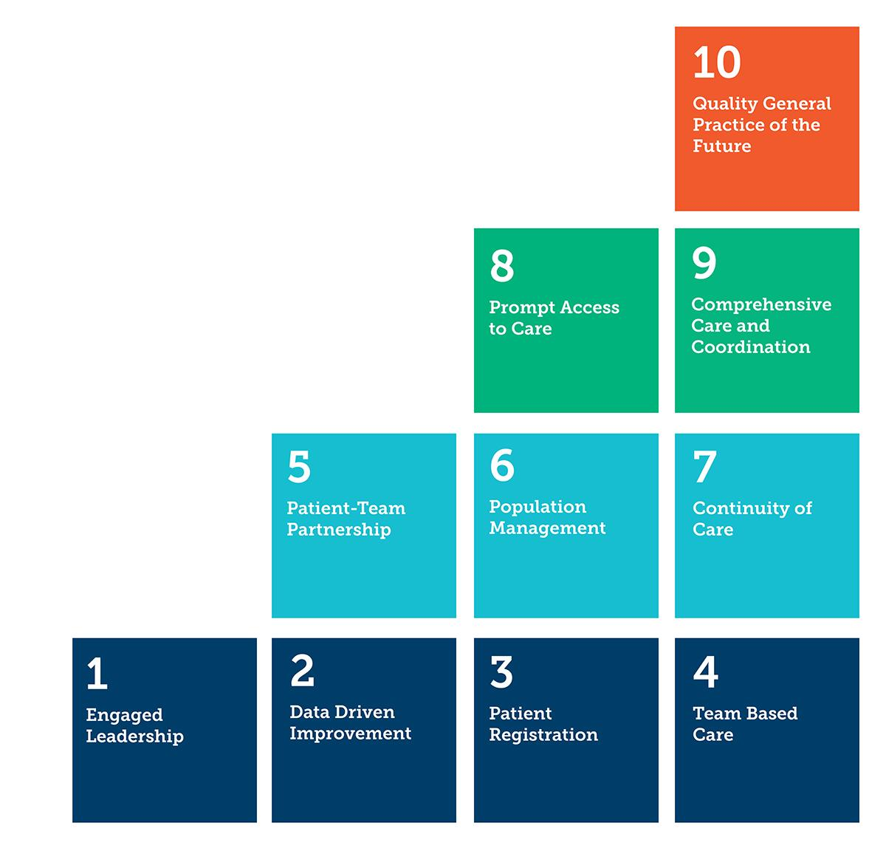
The 10 Building Blocks of High Performing Primary Care
Team based care is one of the foundational elements of the 10 Building Blocks of High Performing Primary Care
Huddles are the first step in implementing and executing Team Based Care
Notes:
The building blocks of primary care are interrelated; however, the order in which they are put in place is important. Before achieving success in the higher order blocks., mastery of the bottom level is important.

Slide 6
Competencies and Tools for Care Teams
Task Distribution Based on Licensure & Ability
Strategic Standing Orders
Empathy, Bias and Humility Training
Self-Management Support
Data-Driven Improvement
Regular Huddles
Community Partnerships
Pre-Visit Work
Warm Handoffs
Empanelment
Care Coordination
Uptalk
Notes:
Team-based are is the fourth foundational block. Much of the focus is in understanding each provider’s total patient panel size (block 3), creating teams with well-trained non-clinicians, optimizing the use of Medical Assistants, and other ways to build capacity by sharing the care.
Definition = the provision of comprehensive health services to individuals, families, and/or their communities by at least two health professionals who work collaboratively along with patients, family caregivers, and community service providers on shared goals within and across settings to achieve care that is safe, effective, patient-centered, timely, efficient, and equitable.*

Slide 7

Why Should We Huddle?
Align the team at the start of the day/clinic session
Allow for planning of the day, identifying spots for additional patient access
Build team culture and improve communication for a more engaged workforce
Prospectively plan for patients who require extra time and assistance
Prepare for staff, provider, or equipment changes
Aligns with PCMH
Notes:
Your Health Center may be a PCMH recognized center and Huddles align with PCMH competencies

Slide 8

Establish the Routine for Huddles
Involve the right people!
  Can be as simple as involving the provider and MA
  Including more team members can work as well, such as case managers, nursing supervisors, and front desk staff
Schedule a time before the day starts
  Huddles should last around 5-10 minutes
  Start at a consistent time that can be integrated into the clinic’s workflow smoothly
  Experimentation with time in the beginning may be necessary
Determine a location for the huddle
  A convenient spot where everyone can easily meet and speak openly about patients: the nurse’s station, a work room, etc.
  Whoever is leading the discussion should have access to a computer in case important patient information needs to be reviewed

Slide 9
Huddles have helped to eliminate these situations:
Confusion about provider availability for scheduling
Lack of awareness of broken equipment or unavailable labs
Lack of preparation for scheduled patients who require extra time and assistance
Staff shortages due to illnesses, vacations, and family emergencies
Chaos due to last-minute schedule changes. Whether caused by patients, providers, office systems, or external factors
Lack of awareness of how each person contributes to the practice's smooth functioning
Notes:
https://www.aafp.org/pubs/fpm/issues/2007/0600/p27.html
Chaos due to last-minute schedule changes, whether caused by patients (cancellations or no-shows), providers (unexpected hospital visits), office systems (computer network down) or external factors (traffic jams, late busses), etc.

Slide 10
Huddles: jump start your practice today
Invite only the necessary people. Key participants are usually nurses, medical assistants, receptionists, and physicians.
Limit the huddle to seven minutes or less. Having everyone stand during the meeting will help keep it short and focused.
Have an agenda. The main purpose of the huddle is to check the schedule for potential slowdowns so you can proactively address them.
  For example, are there any patients who may require more time or assistance due to age, disability, etc.? Who can help? Are there any back-to-back lengthy appointments, such as physicals? Are there any openings that can be filled or chronic no-shows that can be anticipated? Which patients will need to have test results or notes from other physicians ready in the chart?
Notes:
https://www.aafp.org/pubs/fpm/blogs/inpractice/entry/huddles.html

Slide 11
Develop Relationships and Designate Roles
Designate a huddle leader
Use a checklist or template (see handout)
Identify and define additional roles
Develop a strong team culture
  Many practices have found success in designating a nurse supervisor or MA to lead the huddle
  Some practices allow the leader to rotate between staff if multiple MAs or nurses are involved on the team; can lead to a strong culture of teamwork
  The leader role can evolve over time, and the leader should be sure to allow other team members the opportunity to speak up when necessary
  Implementing a huddle with the assistance of a checklist provides structure
  Helps keep conversations concise and focused
  The nurse manager or administrator can review staffing needs and absences for the day and reallocate as necessary
  Schedulers can note available clinic capacity that day and make the team aware of any same day openings and urgent or cancelled visits
  MAs can flag and preventive and chronic care needs
  Include a quick check-in at the beginning of the huddle to center the team and get everyone on the same page
  Share one positive story from the previous day about a staff member

Slide 12
Measuring the Impact of Huddles
Possible metrics to track:
Continuity of care
Wait time
Cycle time
Patient satisfaction
Provider satisfaction
Clinical Quality Measures
Use data and compare several months pre and post care team implementation

Slide 13
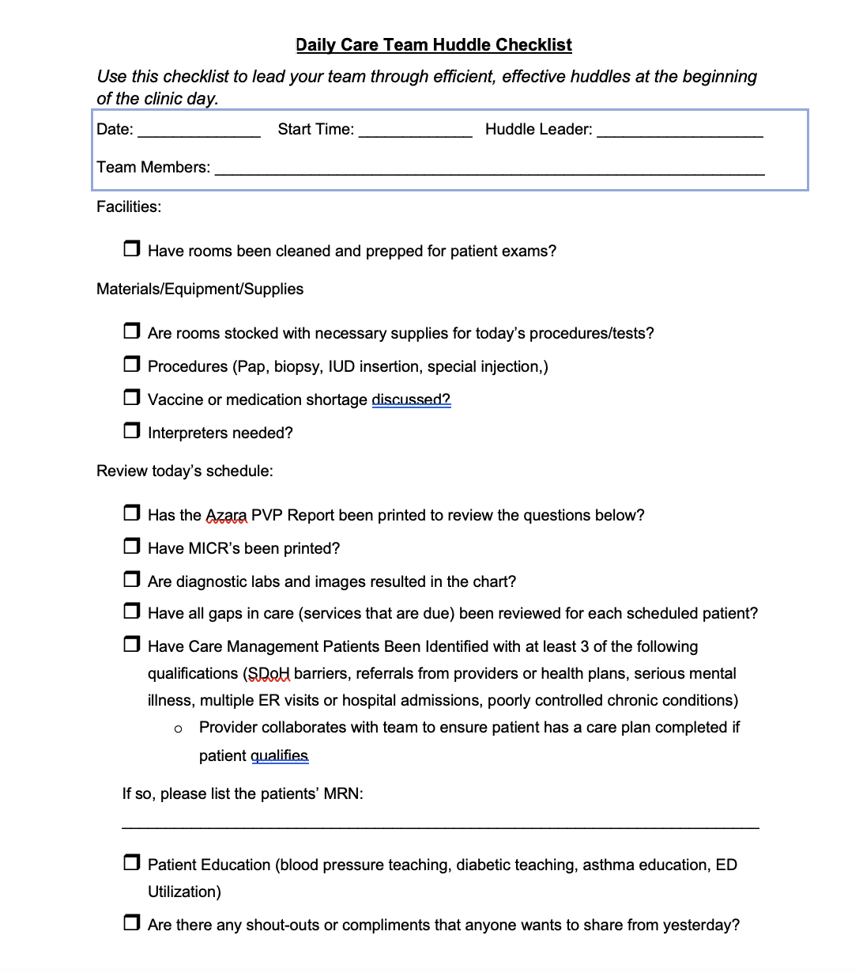
Daily Huddle Checklist at your health center

Slide 14
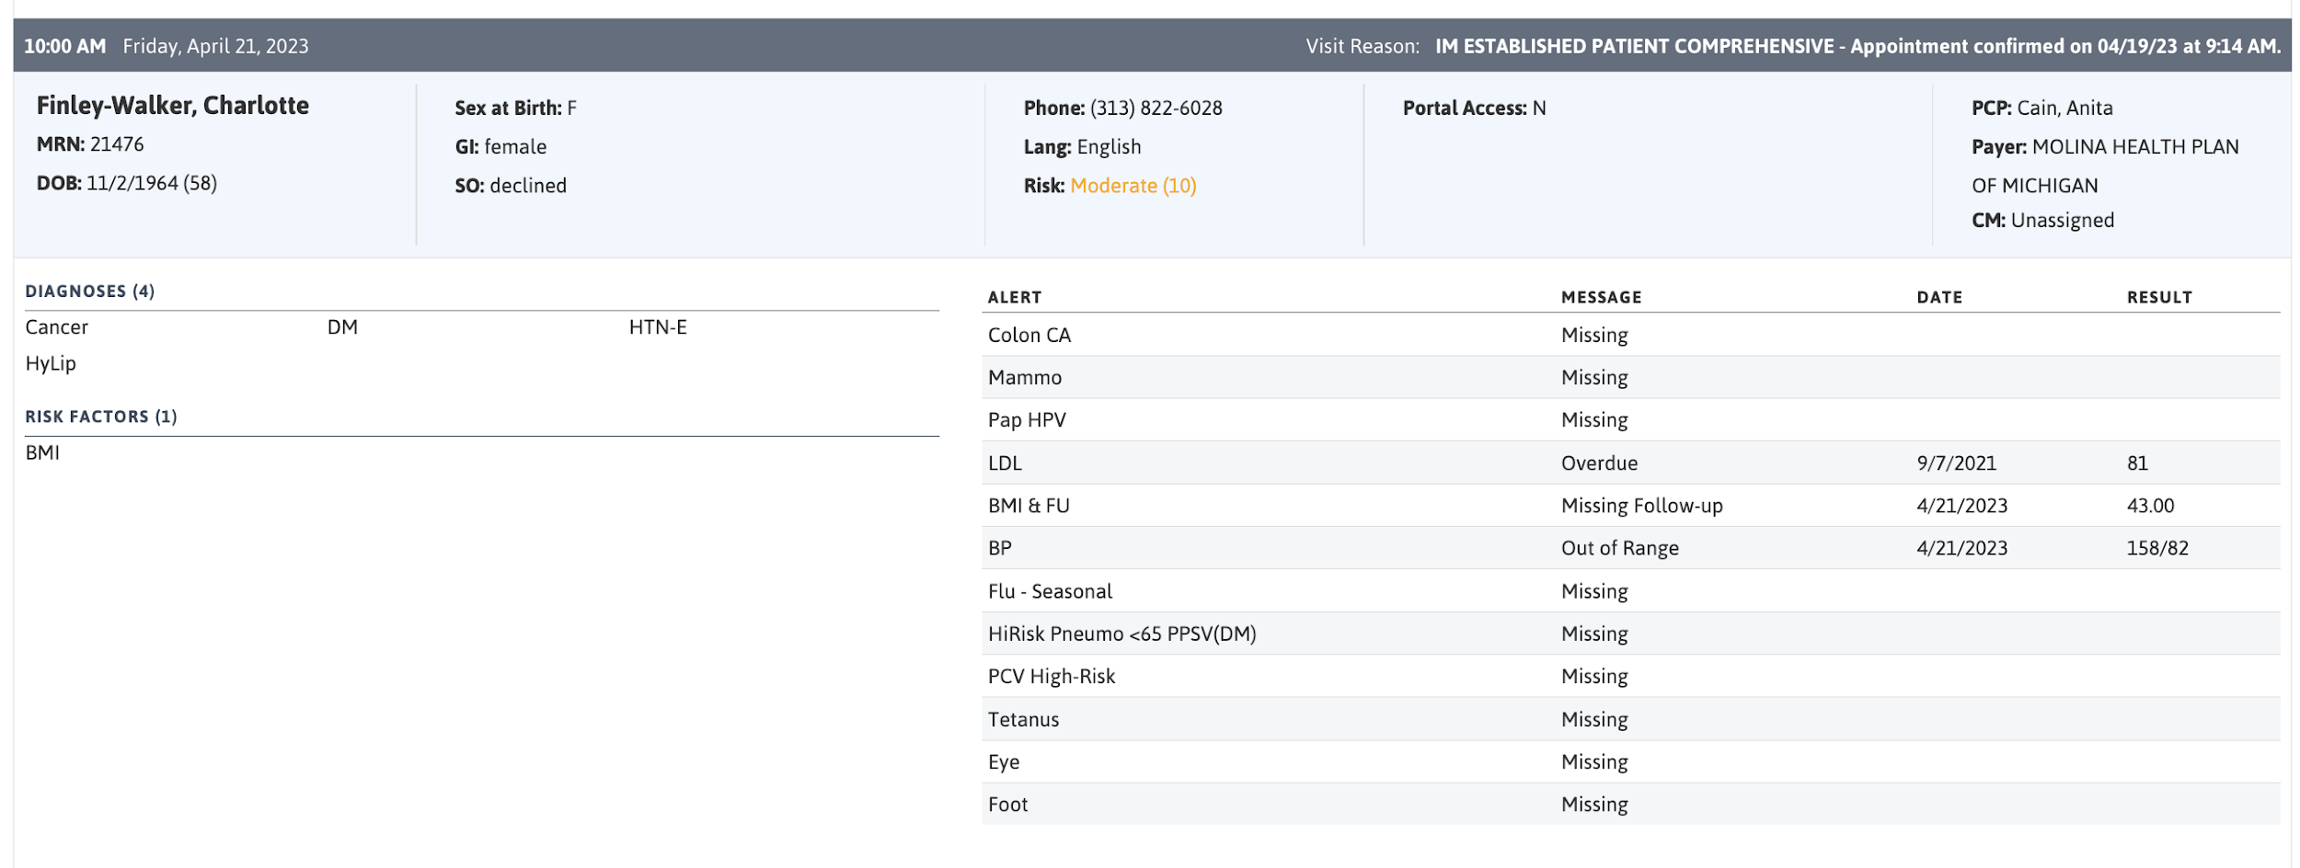
Azara PVP Example
Alert Inconsistencies? Report them!
Notes:
The Azara PVP is a snapshot of the patient appointment. For huddle, the important part to look at is the “Alerts” section. The goal should be for the provider to close all of the alerts at each visit.
If there are inconsistencies with Azara PVP and patient EMR chart, report them to your health center directors and/or Quality Department.

Slide 15
Huddle Workflow at Your Health Center
MA’s perform opening duties
Site-Wide Huddle including Health Center Director and all staff
Care Team Huddle with Provider and MA reviewing Huddle Checklist and Azara PVP
Health Center director follows up with facilities, IT, or others as needed
Notes:
This is an example, tailor to your health center needs.

